Slide 1

Intention and Motor Representation in Action Explanation s.butterfill@warwick.ac.uk corrado.sinigaglia@unimi.it

Slide 2
Which events are actions?
Notes:
Which events are actions?

Slide 3
Which events are actions?
intention
action
R
event
Notes:
In philosophy ... completely neutral on how mental representations connect to bodily movements ...

Slide 4
Which events are actions?
motor representation
intention
action
R
R
action
event
event
Notes:
In psychology ... little to say about actions whose purposes involve things the motor system doesn’t care about---your motor system doesn’t care whether you’re ripping up a real Armani shirt or a fake Armani one, but this sort of difference can affect whether your actions succeed or fail.
You might just say that the two disciplines are talking past each other. But we want to argue that these two pictures are aspects of a larger theory of action.

Slide 5
What is the relation between a purposive action and the outcome or outcomes to which it is directed?
Notes:
A basic question about ordinary, individual action is:
What is the relation between a purposive action and the outcome or outcomes to which it is directed?
Many ordinary purposive actions have many different outcomes.
Grabbing little Isabel by the hands I swing her around, causing her to laugh and, simultaneously, breaking a vase.
In fact the outcome to which this purposive action was directed might not be among its actual outcomes; after all, actions can fail.

Slide 6
What is the relation between a purposive action and the outcome or outcomes to which it is directed?
out
action
out
act
out
out
Notes:
A basic question about ordinary, individual action is:
What is the relation between a purposive action and the outcome or outcomes to which it is directed?
Many ordinary purposive actions have many different outcomes.
Grabbing little Isabel by the hands I swing her around, causing her to laugh and, simultaneously, breaking a vase.
In fact the outcome to which this purposive action was directed might not be among its actual outcomes; after all, actions can fail.

Slide 7
What is the relation between a purposive action and the outcome or outcomes to which it is directed?
out
action
out
out
act
out
out
Notes:
So among all the actual and possible outcomes of my action, one or some are singled out as specially related to this action.
One aspect of the question concerns what singles out the outcome or outcomes, actual or merely possible, to which a particular purposive is directed.
But there is also a second aspect ...

Slide 8
What is the relation between a purposive action and the outcome or outcomes to which it is directed?
wave
out
action
out
reach
act
out
grasp
out
scratch
Notes:
Ordinary purposive actions are sometimes composed of more than one motor action. My swinging Isabel around starts with my reaching for her wrists, grasping them and then spinning us around ... and my action doesn’t include other things which I might be doing simultaneously, like refusing a cup of tea with my eyes or trying to determine whether that smell is coming from Isabel’s sister Hannah’s nappy.

Slide 9
What is the relation between a purposive action and the outcome or outcomes to which it is directed?
wave
out
action
out
reach
act
out
grasp
out
scratch
Notes:
So another aspect of our question is what determines which activities comprise the purposive action and which do not.

Slide 10
What is the relation between a purposive action and the outcome or outcomes to which it is directed?
wave
out
action
out
reach
act
out
grasp
intention or motor representation
out
scratch
Notes:
The standard answer to this question involves intention.
An intention (1) represents an outcome, (2) coordinates the one or several activities which comprise the action; and (3) coordinate these activities in a way that would normally facilitate the outcome’s occurrence.
What binds particular component actions together into larger purposive actions? It is the fact that these actions are all parts of plans involving a single intention.
What singles out an actual or possible outcome as one to which the component actions are collectively directed? It is the fact that this outcome is represented by the intention.
So the intention is what binds component actions together into purposive actions and links the action taken as a whole to the outcomes to which they are directed.
On this picture there is no distinctive role for motor representation in explaining what action is.
It can allow, of course, that in some agents motor representation is involved in performing actions.
But this is treated as having no bearing at all on our question about the relation between actions and the outcomes to which they are directed.
Motor representation is at most an enabling condition for action and has no relevance to understanding what action is.
This view might be acceptable if all motor representations represented only kinematic or dynamic features of actions mere joint displacements or muscle contractions. However, we shall argue that some motor representations represent action outcomes such as grasping, tearing or throwing. Furthermore, as we shall go on to argue, such representations ground purposive actions.

Slide 11
Some motor representations carry information about outcomes.
Notes:
so why do we think this? the first step is to show that some motor representations carry information about outcomes. How do we show this?

Slide 12
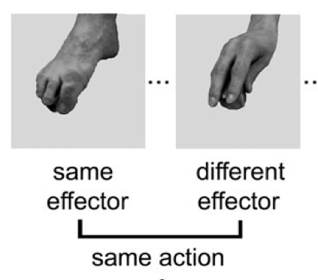
Some motor representations carry information about outcomes.
same outcome
Cattaneo et al (2010)
Notes:
vary kinematic and dynamic features but keep outcome constant.

Slide 13
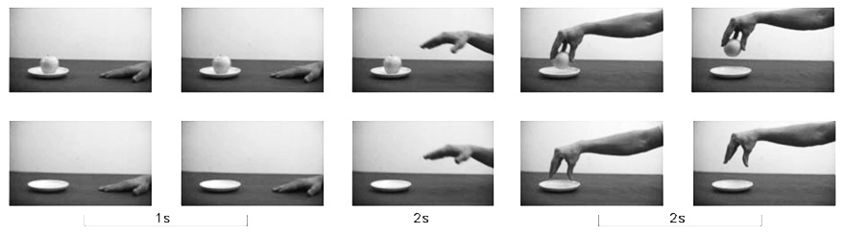
Some motor representations carry information about outcomes.
same outcome
Cattaneo et al (2010)
Villiger et al (2010)
Notes:
keep kinematic and dynamic features constant but vary outcome. There are several ways to do that; one is simply to compare an ordinary grasping action with the same movements performed in the absence of the target object.

Slide 14
Some motor representations carry information about outcomes.
same outcome
Cattaneo et al (2010)
Villiger et al (2010)

Slide 15
Some motor representations carry information about outcomes.
Information about outcomes guides planning.

Slide 16
Some motor representations carry information about outcomes.
Information about outcomes guides planning.
hand-1
reach
grasp
move
arrive
release
hand-2
reach
grasp
move
place
release

Slide 17
Some motor representations carry information about outcomes.
Information about outcomes guides planning.
get it
move it
position it
hand-1
reach
grasp
move
arrive
release
hand-2
reach
grasp
move
place
release

Slide 18
Some motor representations carry information about outcomes.
Information about outcomes guides planning.
Move it from there to here
get it
move it
position it
hand-1
reach
grasp
move
arrive
release
hand-2
reach
grasp
move
place
release

Slide 19
Some motor representations carry information about outcomes.
Information about outcomes guides planning.
Move it from there to here
get it
move it
position it
hand-1
reach
grasp
move
arrive
release
hand-2
reach
grasp
move
place
release

Slide 20
Some motor representations carry information about outcomes.
Information about outcomes guides planning.
Some motor representations represent outcomes
Move it from there to here
get it
move it
position it
hand-1
reach
grasp
move
arrive
release
hand-2
reach
grasp
move
place
release

Slide 21
What is the relation between a purposive action and the outcome or outcomes to which it is directed?
wave
out
action
out
reach
act
out
grasp
intention or motor representation
out
scratch

Slide 22
What is the relation between a purposive action and the outcome or outcomes to which it is directed?
wave
out
action
out
reach
act
out
grasp
intention or motor representation
out
scratch
Notes:
Now as Elisabeth Pacherie has argued (and I’ve had a go at arguing this in joint work with Corrado Sinigaglia recently too),
motor representations are relevantly similar to intentions.
Of course motor representations differ from intentions in some important ways (as Pacherie also notes).
But they are similar in the respects that matter for explaining the purposiveness of action.
(1) Like intentions, some motor representations represent outcomes (and not merely patters of joint displacement, say).
(2) Like intentions, some motor representations play a role in coordinating multiple more component activities by virtue of their role as elements in hierarchically structured plans.
(3) And, like intentions, some motor representations coordinate these activities in a way that would normally facilitate the outcome’s occurrence.
The claim is not that \emph{all} purposive actions are linked to outcomes by motor representations, just that some are.
In some cases, the purposiveness of an action is grounded in a motor representation of an outcome; in other cases it is grounded in an intention.
And of course in many cases it may be that both intention and motor representation are involved.

Slide 23
motor representation = intention ? No !

Slide 24
motor representation = intention ? No !

Slide 25
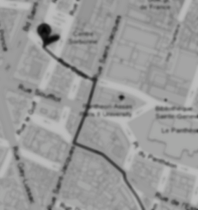
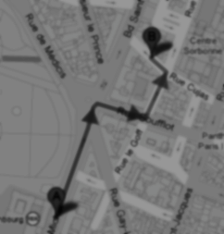
< different content >
Notes:
As background we first need a generic distinction between content and format. Imagine you are in an unfamiliar city and are trying to get to the central station. A stranger offers you two routes. Each route could be represented by a distinct line on a paper map. The difference between the two lines is a difference in content. Each of the routes could alternatively have been represented by a distinct series of instructions written on the same piece of paper; these cartographic and propositional representations differ in format. The format of a representation constrains its possible contents. For example, a representation with a cartographic format cannot represent what is represented by sentences such as `There could not be a mountain whose summit is inaccessible.'\footnote{ Note that the distinction between content and format is orthogonal to issues about representational medium. The maps in our illustration may be paper map or electronic maps, and the instructions may be spoken, signed or written. This difference is one of medium.} The distinction between content and format is necessary because, as our illustration shows, each can be varied independently of the other.

Slide 26
< different content >
Head down Rue Cujas toward Rue Victor Cousin. Turn right onto Rue Saint-Jacques. ...
Take RER B and get out at the Luxembourg station, from there it's less than 5 minutes walk.
< different format >
Notes:
As background we first need a generic distinction between content and format. Imagine you are in an unfamiliar city and are trying to get to the central station. A stranger offers you two routes. Each route could be represented by a distinct line on a paper map. The difference between the two lines is a difference in content. Each of the routes could alternatively have been represented by a distinct series of instructions written on the same piece of paper; these cartographic and propositional representations differ in format. The format of a representation constrains its possible contents. For example, a representation with a cartographic format cannot represent what is represented by sentences such as `There could not be a mountain whose summit is inaccessible.'\footnote{ Note that the distinction between content and format is orthogonal to issues about representational medium. The maps in our illustration may be paper map or electronic maps, and the instructions may be spoken, signed or written. This difference is one of medium.}

Slide 27
Head down Rue Cujas toward Rue Victor Cousin. Turn right onto Rue Saint-Jacques. ...
=
?
Notes:
Format matters because only where two representations have the same format can they be straightforwardly inferentially integrated.
To illustrate, let’s stay with representations of routes.
Suppose you are given some verbal instructions describing a route. You are then shown a representation of a route on a map and asked whether this is the same route that was verbally described. You are not allowed to find out by following the routes or by imagining following them.
Special cases aside, answering the question will involve a process of translation because two distinct representational formats are involved, propositional and cartographic. It is not be enough that you could follow either representation of the route. You will also need to be able to translate from at least one representational format into at least one other format.

Slide 28
Head down Rue Cujas toward Rue Victor Cousin. Turn right onto Rue Saint-Jacques. ...
e.g. rapid identification of key landmarks; slow translation into compass directions
< different format >
Rapid identification of direction of start from end (projection-dependent)
< different performance>
Notes:
How in general can we identify or distinguish representational formats? Because representational formats are typically associated with characteristic performance profiles, it is sometimes possible to infer similarities and differences in representational format from similarities and differences in the processes in which representations feature.
To illustrate, suppose that you have a route representation and I want to work out whether it this representation has a cartographic or propositional format. One way to do this might be to test your performance on different tasks. If the representation is propositional you are likely to be relatively fast at identifying key landmarks but relatively slow at translating the route into a sequence of compass directions; but the converse will be true if your representation is cartographic.

Slide 29
imagine
seeing
Notes:
The same principle---distinguishing and identifying formats by measuring characteristic processing profile---works for mental representations too.
To illustrate, compare imagining seeing an object moving with actually seeing it move. For this comparison we need to distinguish two ways of imagining seeing. There is a way of imagining seeing which phenomenologically is something like seeing except that it does not necessarily involve being receptive to stimuli. This way of imagining seeing, sometimes called `sensory imagining', is commonly distinguished from cognitive ways of imagining seeing which might for example involve thinking about seeing.
It is this way of imagining seeing an object move that we wish to compare with actually seeing an object move.

Slide 30
imagine
actually
seeing
seeing
1
Notes:
Imagining seeing an object move and actually seeing an object move have similarities in characteristic performance profile. For instance, whether an object can be seen all at once depends on its size and distance from the perceiver; strikingly, when subjects imagine seeing an object, whether they can imagine seeing it all at once depends in the same way on size and distance (\citealp{kosslyn:1978_measuring}; \citealp[p.\ 99ff]{kosslyn:1994_image}).
Also, how long it takes to imagine looking over an object depends on the object's subjective size in the same way that how long it would take to actually look over that object would depend on its subjective size \citep{kosslyn:1978_visual}.
The similarities in characteristic performance profile and the particular patterns of interference are good (if non-decisive) reasons to conjecture that imagining seeing and actually seeing involve representations with a common format.

Slide 31
imagine
actually
seeing
acting
seeing
acting
1
2
Notes:
One way of imagining action is phenomenologically something like acting except that such imaginings are not necessarily responsive to the features of actual objects and do not necessarily result in bodily movements.
There is evidence that the way imagining performing an action unfolds in time is similar in some respects to the way actually performing an action of the same type would unfold.
For instance, how long it takes to imagine moving an object is closely related to how long it would take to actually move that object \citep{decety:1989_timing, decety:1996_imagined, Jeannerod:1994oz}.
In addition, for actions such as grasping the handle of a cup, manipulating the target object in ways that would make the action harder (such as orienting the cup's handle to make it less convenient for you to grasp) make a corresponding difference to the effort involved in imagining performing the action \citep{parsons:1994_temporal, frak:2001_orientation}.

Slide 32
imagine
actually
3
seeing
acting
seeing
acting
1
2
Notes:
Contrast imagining rotating a ball with imagining seeing a ball rotate.
As is implied by what we’ve already said, these have quite different characteristic performance profiles.
How quickly the former can be done is a function of how long it would take the agent to rotate the ball, whereas how quickly the latter can be done depends on how rapidly the ball can rotate and still be perceived as rotating.
Further, in some cases rotating a ball clockwise is easier than rotating it anti-clockwise, and so is imagining a ball rotate. By contrast, the effort involved in actually seeing or imagining seeing a ball rotate does not similarly differ depending on direction.

Slide 33


imagine
actually
3
seeing
acting
seeing
acting
1
2
Fiori et al (submitted)

Slide 34
imagine
actually
3
seeing
acting
seeing
acting
1
2
imagine (cognitive)
4
acting

Slide 35
No motor representations are propositional attitudes.
Notes:
This brings me to the argument ...

Slide 36
Only representations with a common format can be inferentially integrated.
Any two intentions can be inferentially integrated in practical reasoning.
My intention that I visit Glasgow on Monday is a propositional attitude.
No motor representations are propositional attitudes.
Notes:
This brings me to the argument ...

Slide 37
Only representations with a common format can be inferentially integrated.
Any two intentions can be inferentially integrated in practical reasoning.
My intention that I visit Glasgow on Monday is a propositional attitude.
All intentions are propositional attitudes.
No motor representations are propositional attitudes.

Slide 38
Only representations with a common format can be inferentially integrated.
Any two intentions can be inferentially integrated in practical reasoning.
My intention that I visit Glasgow on Monday is a propositional attitude.
All intentions are propositional attitudes.
No motor representations are propositional attitudes.
Notes:
This brings me to the argument ...

Slide 39
Only representations with a common format can be inferentially integrated.
Any two intentions can be inferentially integrated in practical reasoning.
My intention that I visit Glasgow on Monday is a propositional attitude.
All intentions are propositional attitudes.
No motor representations are propositional attitudes.
No motor representations are intentions
Notes:
This brings me to the argument ...

Slide 40
Only representations with a common format can be inferentially integrated.
Any two intentions can be inferentially integrated in practical reasoning.
My intention that I visit Glasgow on Monday is a propositional attitude.
All intentions are propositional attitudes.
No motor representations are propositional attitudes.
No motor representations are intentions
Notes:
This step is questionable. I don’t have an argument for this and I’m not sure it isn’t terminological.
What I care about is that we distinguish attitudes according to the processes in which they feature.
So if you like we could distinguish two kinds of intention, one propositional the other motor.
As long as we distinguish representations of different formats I don’t see that it matters too much whether we call them all intentions or whether we use that term for only some of them.
[*intention in narrow sense and intention in the broad sense (cf desire); in the broad sense, desires can be intentions and so can instructions.]

Slide 41
Only representations with a common format can be inferentially integrated.
Any two intentions can be inferentially integrated in practical reasoning.
My intention that I visit Glasgow on Monday is a propositional attitude.
All intentions are propositional attitudes.
No motor representations are propositional attitudes.
No motor representations are intentions
Notes:
So where does this leave us?
The question was whether reciprocal agent-neutral motor intentions could count as shared intentions.

Slide 42
The Interface Problem:

Slide 43
The Interface Problem:
Some actions involve both intention and motor representation

Slide 44
The Interface Problem:
Reciprocal agent-neutral motor representations:
i. represent outcomes;
ii. ground the purposiveness of some
actions
Some actions involve both intention and motor representation

Slide 45
The Interface Problem:
Reciprocal agent-neutral motor representations:
i. represent outcomes;
ii. ground the purposiveness of some
actions
Two outcomes, A and B, match in a particular context just if, in that context, either the occurrence of A would normally constitute or cause, at least partially, the occurrence of B or vice versa.
Some actions involve both intention and motor representation

Slide 46
The Interface Problem:
How are non-accidental matches possible?
Reciprocal agent-neutral motor representations:
i. represent outcomes;
ii. ground the purposiveness of some
actions
Two outcomes, A and B, match in a particular context just if, in that context, either the occurrence of A would normally constitute or cause, at least partially, the occurrence of B or vice versa.
Some actions involve both intention and motor representation

Slide 47
The Interface Problem:
How are non-accidental matches possible?
Reciprocal agent-neutral motor representations:
i. represent outcomes;
ii. ground the purposiveness of some
actions; and
iii. differ in format from intentions.
Two outcomes, A and B, match in a particular context just if, in that context, either the occurrence of A would normally constitute or cause, at least partially, the occurrence of B or vice versa.
Some actions involve both intention and motor representation

Slide 48
The Interface Problem:
How are non-accidental matches possible?
Reciprocal agent-neutral motor representations:
i. represent outcomes;
ii. ground the purposiveness of some
actions; and
iii. differ in format from intentions.
Two outcomes, A and B, match in a particular context just if, in that context, either the occurrence of A would normally constitute or cause, at least partially, the occurrence of B or vice versa.
Some actions involve both intention and motor representation
Notes:
interface problem arises in the individual case as well as the joint case, of course ...

Slide 49
Head southeast on Rue Cujas toward Rue Victor Cousin. Turn right onto Rue Saint-Jacques. ...
=
?
Notes:
There is a way to make the problem of comparison between representational formats trivial

Slide 50
Follow that route
=
?
Notes:
Suppose one representation involves a demonstrative that refers by deferring to another representation

Slide 51
Follow that route
=
?
Notes:
Then the comparison doesn’t require translation between formats after all.
Maybe the same can be true for intentions and motor representations.
Maybe intentions can involve demonstrative concepts which refer to actions by deferring to motor representations?
[*cut:
Set that aside, suppose it can be solved --- essentially because MR must give rise to experience of action.
On this view, it is demonstrative deference to motor representation that connects intentions to bodily movements.
Only by recognising how intentions interlock with motor representations can we hope to understand how our intentions ever make a difference to the world around us.
On this view experience of action plays a novel role.
Action experiences in which motor representations feature, such as those associated with motor imagery and those associated with really acting, are arguably necessary for there to be concepts which are constituents of intentions and refer to actions by deferring to motor representations.
But if, as we conjecture, such deference is necessary for intentions to properly and reliably result in bodily movements, it may turn out that intentionally acting in the world de- pends on action experiences featuring motor representation.
Much as on some views thought about objects depends on perceptual experience (e.g. Campbell 2002), so also intending actions may depend on motor experience.

Slide 52
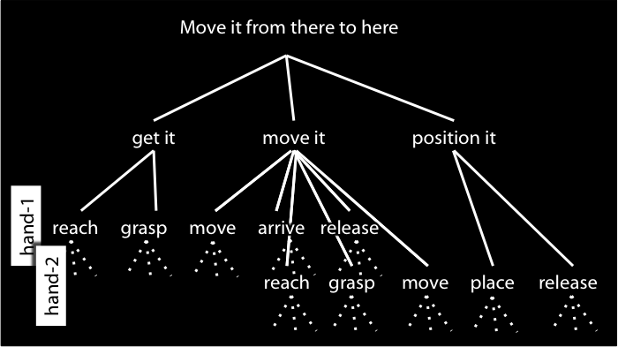
Do that
=
?
Notes:
But we can’t point to motor representations like we can point to maps!
What we need for reference by deference to a motor representation is experience of motor action.
And if you think about motor imagination it seems quite plausible that we do have such experiences.
So here’s the thought:
There are no direct inferential connections between intentions and motor representations.
Harmony is ensured by the fact that where an intention involves a bodily movement, either executing that intention involves forming a further intention or else the intention involves a demonstrative that refers to an action by deferring to a motor representation.
So what connects intentions to motor representations---what connects the reflective to the pre-reflective---is the use of demonstratives, and this depends on experience of motor action.
Much as on some views all thought about objects ultimately depends on perceptual experience (e.g. Campbell 2002), so also intending bodily actions may ultimately depend on motor experience.
Experience anchors the reflective in the pre-reflective.

Slide 53
Notes:
But we can’t point to motor representations like we can point to maps!
What we need for reference by deference to a motor representation is experience of motor action.
And if you think about motor imagination it seems quite plausible that we do have such experiences.
So here’s the thought:
There are no direct inferential connections between intentions and motor representations.
Harmony is ensured by the fact that where an intention involves a bodily movement, either executing that intention involves forming a further intention or else the intention involves a demonstrative that refers to an action by deferring to a motor representation.
So what connects intentions to motor representations---what connects the reflective to the pre-reflective---is the use of demonstratives, and this depends on experience of motor action.
Much as on some views all thought about objects ultimately depends on perceptual experience (e.g. Campbell 2002), so also intending bodily actions may ultimately depend on motor experience.
Experience anchors the reflective in the pre-reflective.

Slide 54
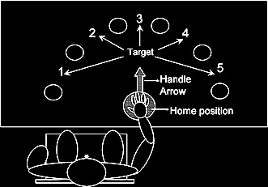
(Zhang and Rosenbaum 2007)
Notes:
Motor representations are involved in this kind of planning ...
[Motor representations enable quite sophisticated planning over short periods of time and sequences of action; for example, how you grasp a pointer will depend on what you are about to do with it \citep{zhang:2007_planning}.
This sort of planning does not need intentions at all. So what are intentions for?

Slide 55
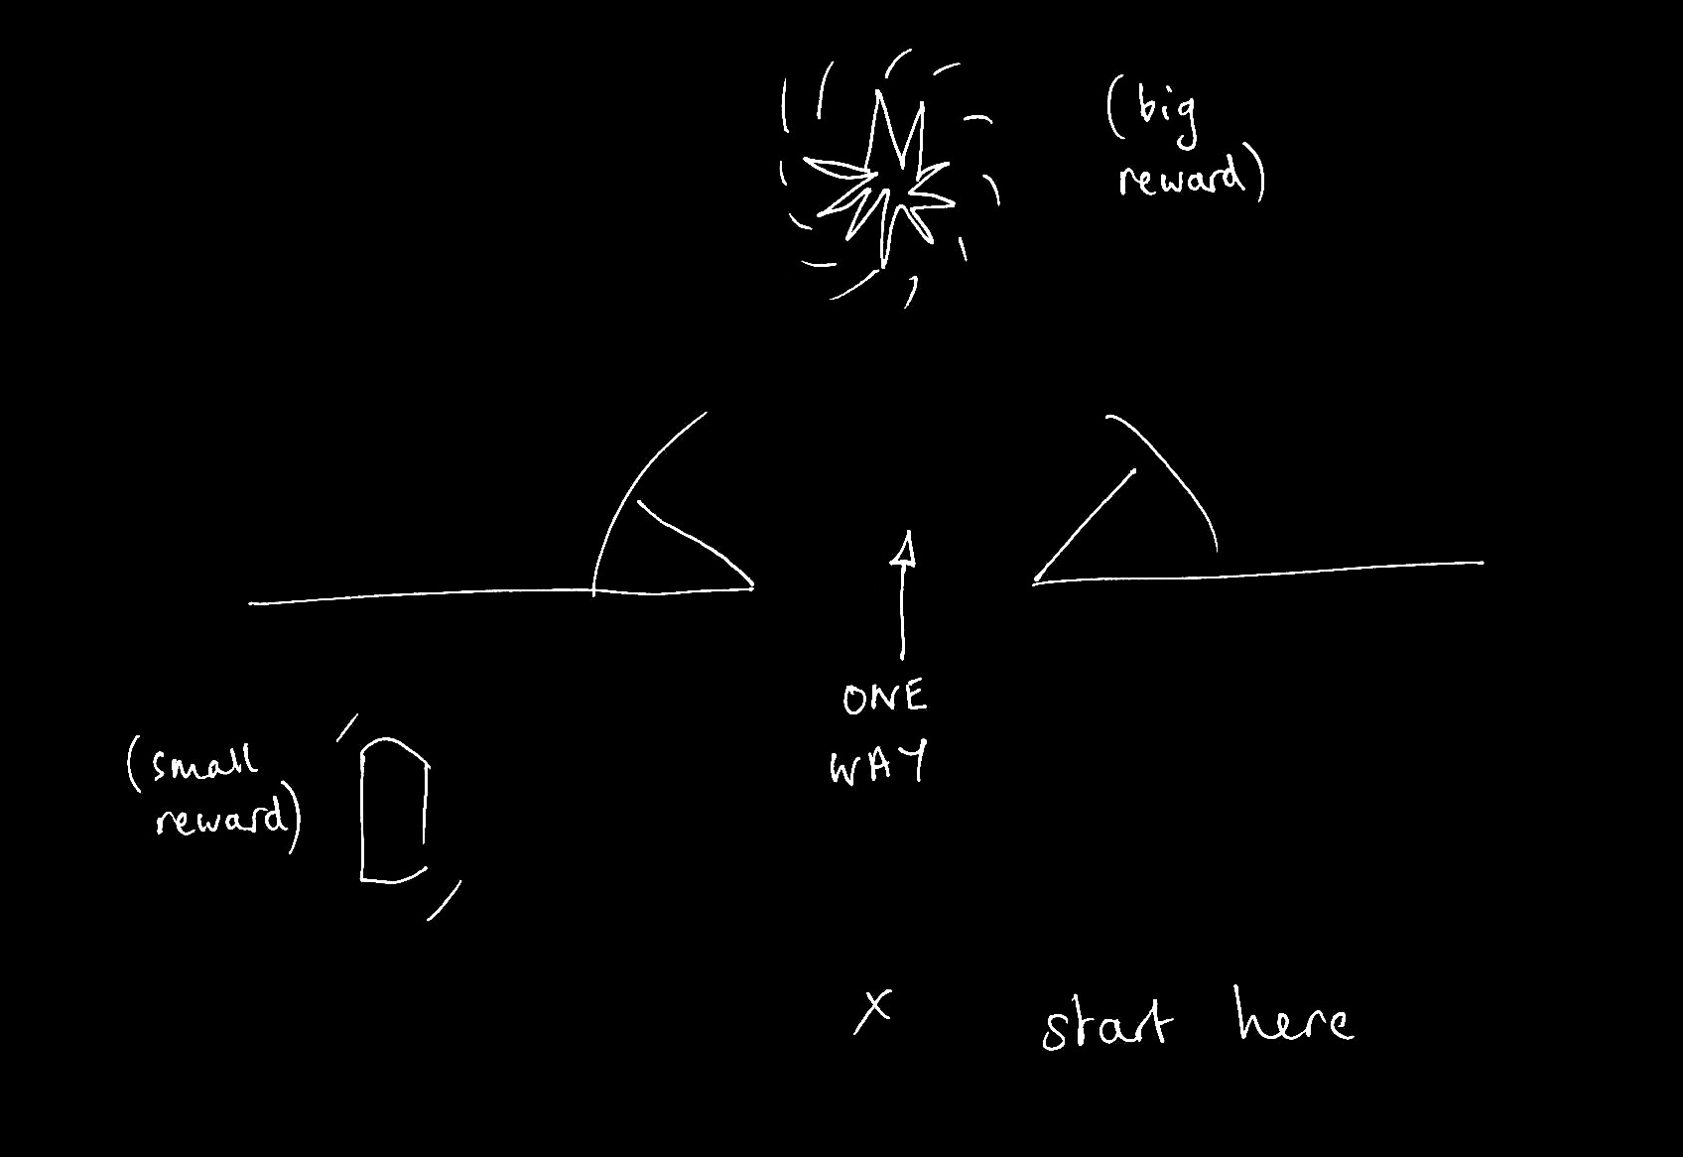
Notes:
Intentions are involved in this kind of planning ...
\emph{Intentions are for planning multiple separate actions over longer periods of time; and for planning multiple separate actions whose execution is mutually constraining where the outcomes cannot be represented motorically.}
This is a case where intentions are really needed --- can’t act on strongest desire (for the big reward) if want to maximise rewards by collecting the small and the large reward.
And can’t rely on motor representation because the motor system doesn’t care about things that cannot be represented in motor terms.
Not all purposive actions involve any planning of this sort.
Now you could imagine a two-person version of this task where we are rewarded for what we collectively achieve. In this case it’s optimal if one of us goes for the small reward and the other goes for the large reward. I think it’s this kind of planning that shared intention is really for.

Slide 56
